Slide 1
PREDICTING PRE-OWNED CAR PRICES
Anjali Sebastian

Slide 2

INTRODUCTION
Motivation
Objectives
Goals
Pricing Guide
Get the best deals ?
Feature Dependent Depreciation
Color, brand?
Develop a model that can reasonably predict price of a used car
Collect sufficient data and clean it
Understand correlations
Develop a model using supervised linear regression
Test the model - better than a monkey

Slide 3
METHODOLOGY
Web Scrapping
Data Cleaning
Data Encoding
Compare Models
Simple Linear Regression
Lasso and Ridge Regression with Cross Validation
Select Best Model
Test
Explore and Transform

Slide 4
DATA AND TOOLS
Web Scraping
Scraped 1700+ pages from carmax.com
30+ parameters … miles, horsepower, curb weight
Cars around the Seattle and Portland
Cleaning Data
Cleaning and Identifying Outliers
Encoding Data
Exterior color - light, dark, prime
Brands - luxury
Chrome Web Driver
Selenium
Pandas Lib
Statsmodel
Sklearn
Matplotlib
Seaborn
Beautiful Soup

Slide 5
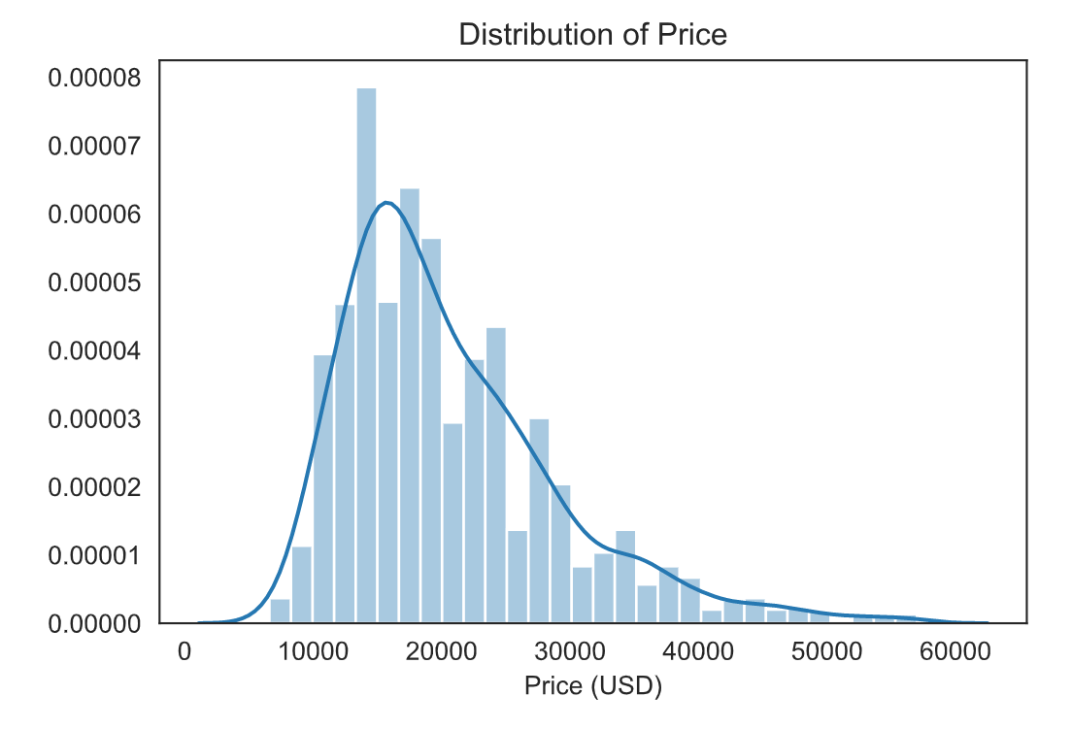
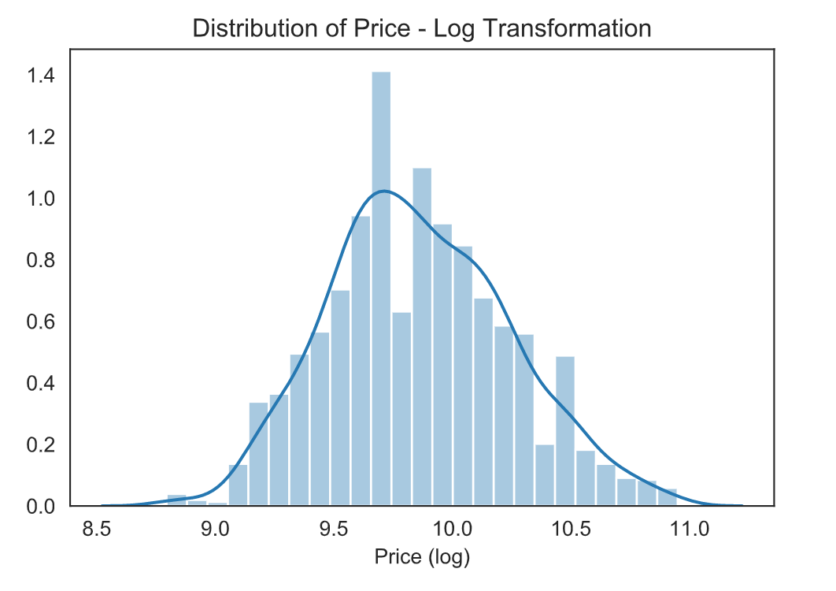
FEATURE ENGINEERING
Log Transform Price
Heteroskedastic
High correlation between features
Engine Size vs #cylinders > 0.9
Linear Regression – use P-values to remove features
Transforming features vs. target

Slide 6
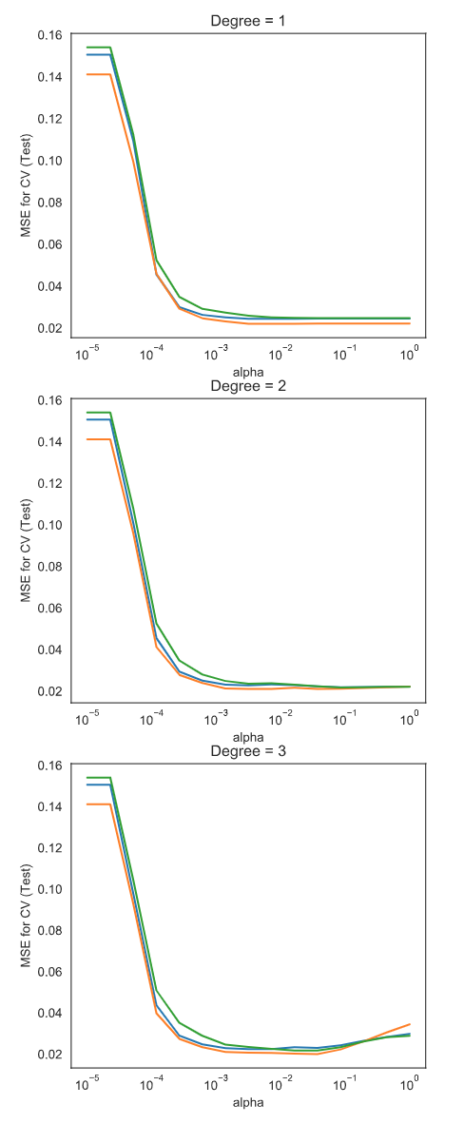
COMPARING MODELS
Underfitting
Type | Polynomial Degree | Alpha | MSE-Train | R² - Train
Ridge | 1 | 1.0 | 0.02267 | 0.84693
Ridge | 2 | 1.0 | 0.01636 | 0.88949
Ridge | 3 | 1.0 | 0.01196 | 0.91925
Lasso | 1 | 0.00026 | 0.02271 | 0.84664
Lasso | 2 | 0.00011 | 0.01657 | 0.88812
Lasso | 3 | 0.00026 | 0.01459 | 0.90144
Good fit
Overfitting
Use LassoCV and RidgeCV for running 3-fold Cross-validation
MSE_PATH_ to get MSE for the test
Plotted MSE Test for assessing fit
Why Ridge ?

Slide 7
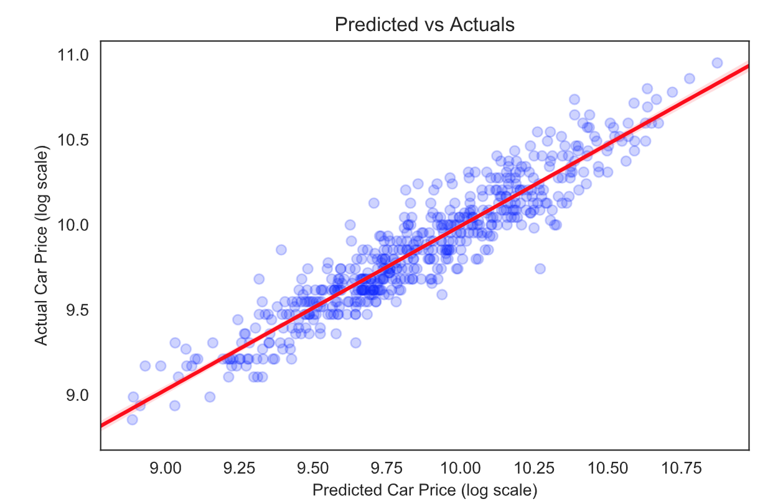
RESULTS
R² Test = 0.876
MSE Test = 0.017
MSE = e^{sqrt(0.017)} = 1.12 ~ 1.1%

Slide 8
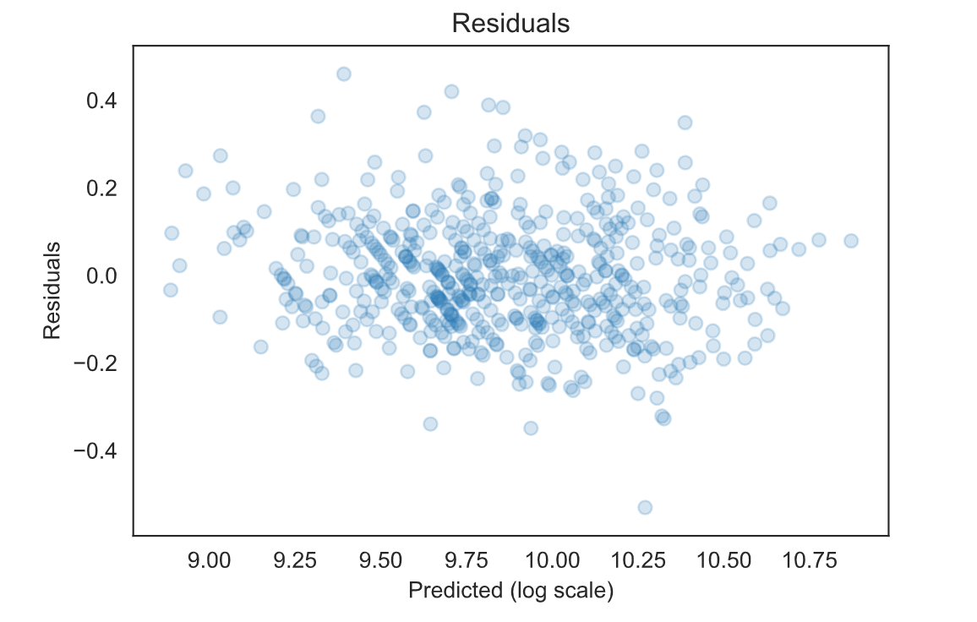
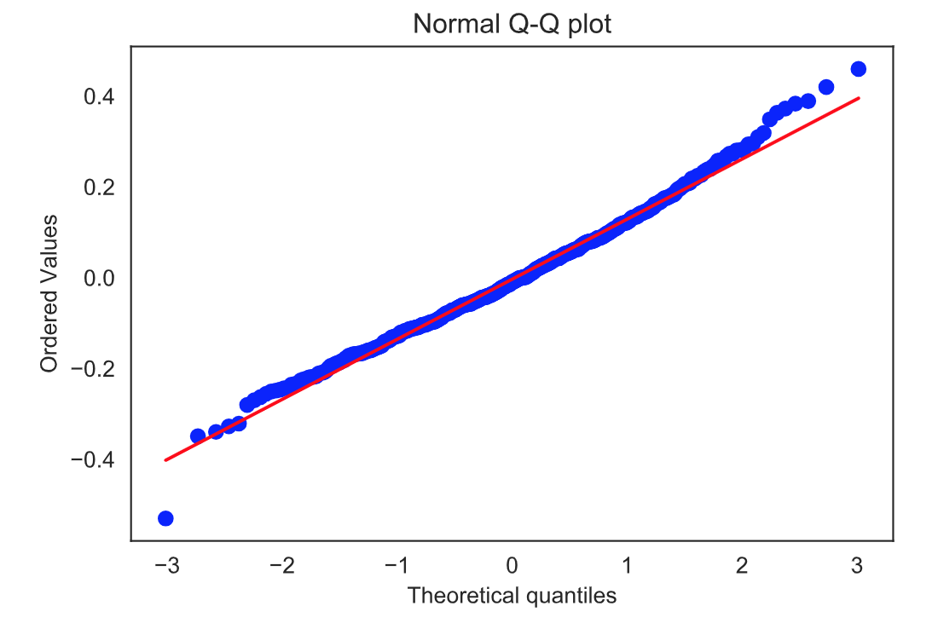
RESULTS

Slide 9
CONCLUSION & FUTURE WORK
Are we better than a monkey ?
Definitely
Can we use this model as a price guide ?
Case extreme outlier, residual - GMC Yukon SLT, 2017
Can we identify feature dependent depreciation?
Future Work
Original Price as a feature
More data points
Have models specific for a brand, year
Unsupervised learning to cluster brands and specific models
Predict car depreciation of a new car

Slide 10
APPENDIX

Slide 11
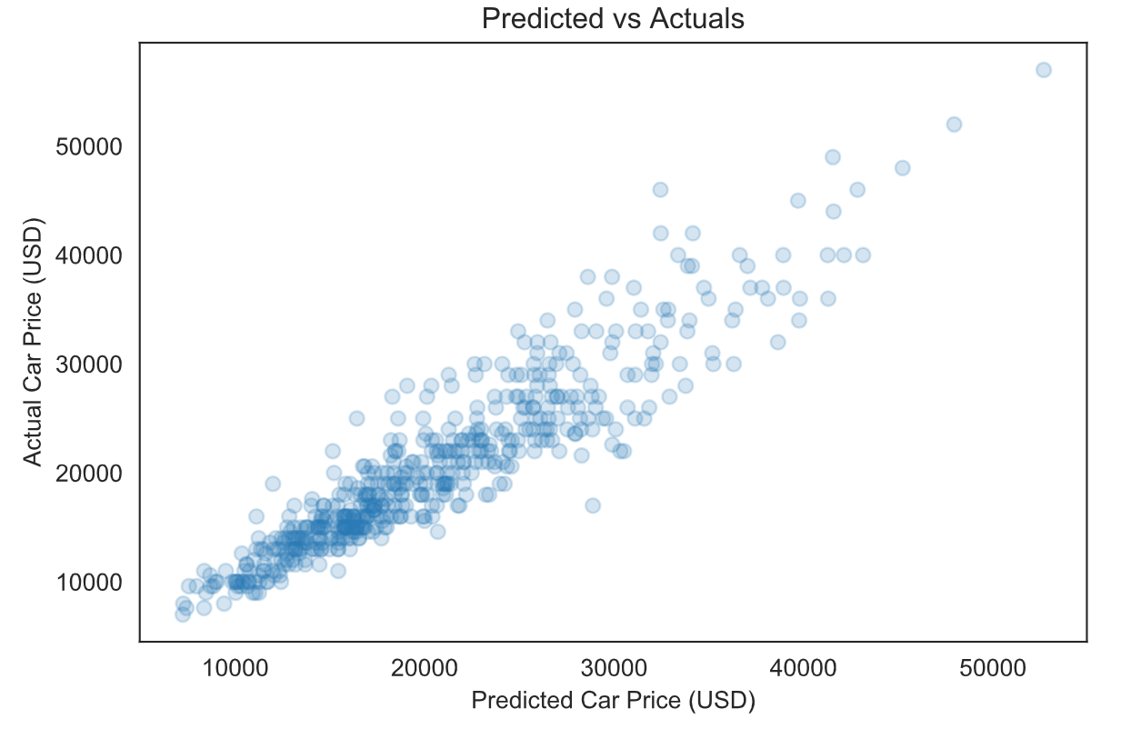
PREDICTED VS. ACTUALS (RE- TRANSFORMED)

Slide 12
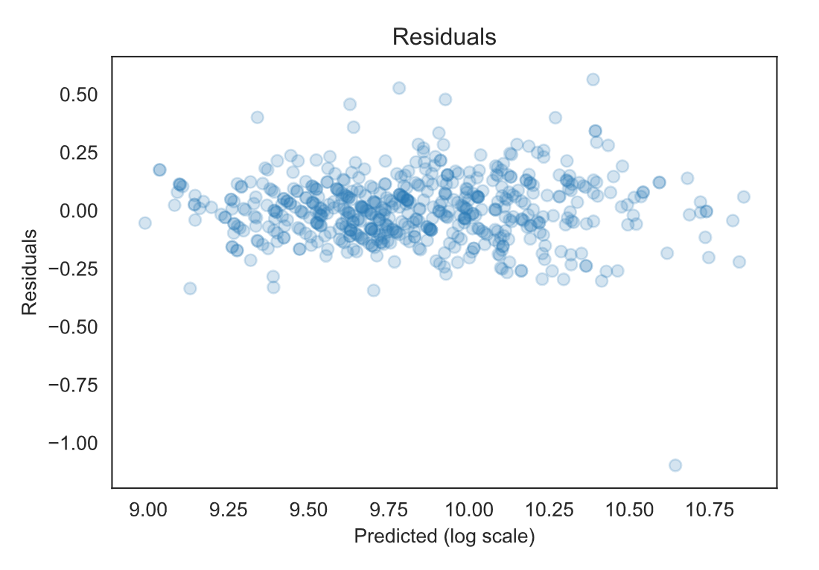
RESIDUALS WITH OUTLIER
GMC Yukon SLT, 2017

Slide 13
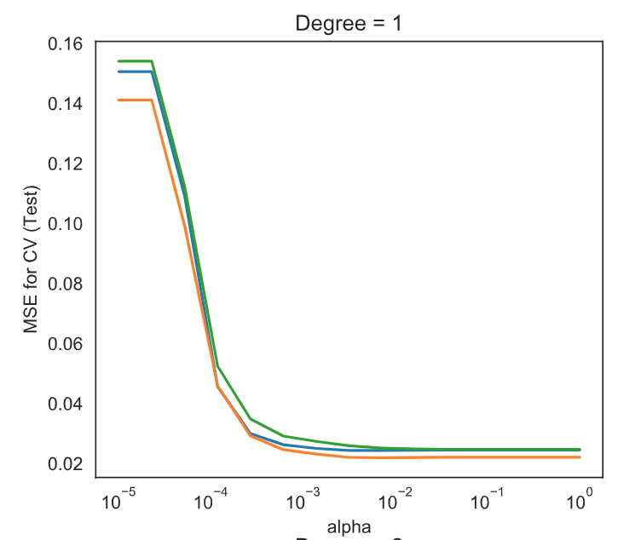
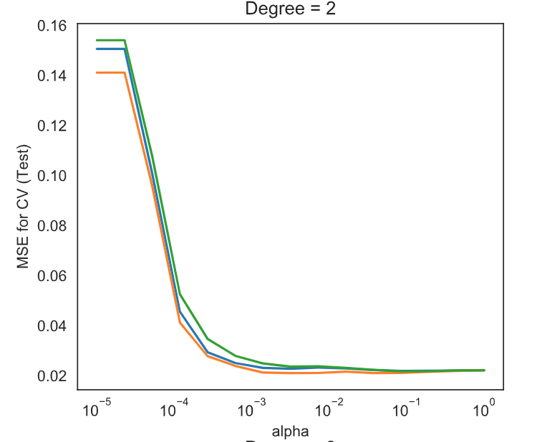
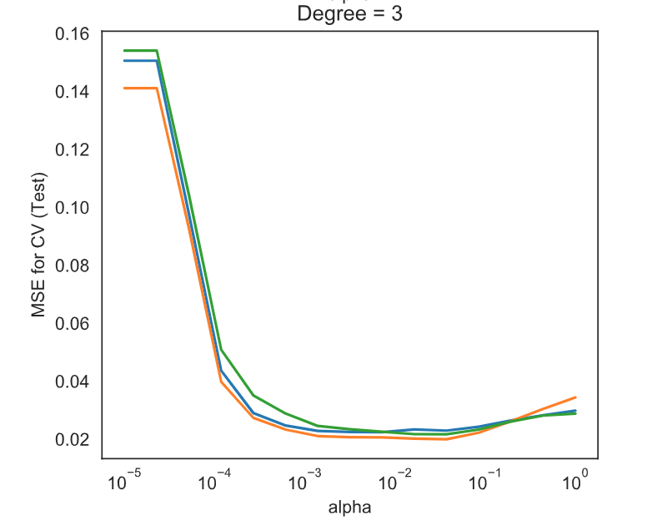
OVER FITTING AND UNDERFITTING

